Slide 1

Unit-4 Validations/Data Annotations, Areas & State Management
Web Programming using .NET
#2305CS311
Prof. Madhuresh R Fichadiya
Computer Science & Engineering Department
madhuresh.fichadiya@darshan.ac.in
8866961282

Slide 2

Looping
Outline
Validation/Data Annotations
Client Side
Server Sie
MVC Areas
Overview
Adding Area in a Project
Model Binding
Default Model Binder
IFormCollection Interface
Bind Attribute
Session Management

Slide 3
Validations
Section – 4.1

Slide 4
Why Validation?
When we developed any type of application such as web, desktop or mobile based, in all the application one key part of development is Data Validation & Proper Navigation.
The validations always ensure us that the data is accurate & correct, whenever in future if we want to analyze the data, all necessary information comes to us in proper form of data.
Normally users always fill the data with necessary information and submit it or select it. But sometimes the user make few mistakes while filling or selecting data.
In this case, validations is required to ensure that the user always prompts with proper validation messages like..
The field First Name is required.
Please enter valid Email Address
Please enter Age value between 1 to 120 etc.
This type of message known as user defined validations messages to collect proper data.

Slide 5
What Are the Validations?
Validation is the set of rules which we define on the input fields on the webform page.
When user fills the data anywhere on web or mobile, applications must validate those data first weather it is correct or not, because nowadays too much dirty/noisy data on web (Data Cleaning & other techniques are required to clean the data)
If it is correct, then application send those data to the server for processing in the database.
If it not in correct format, then it throws/displays an error messages providing necessary information about what are the corrections needs to be done by the user.
We have certain types of validations which we can use as per the user requirements:
Client-Side Validation
Server-side Validation

Slide 6
1. Client Side Validation
Client-side validation in ASP.NET Core is essential for enhancing user experience by providing immediate feedback on form inputs.
For Client-Side Validation, Install Required Libraries: jQuery, jQuery.validate, and jQuery.validate.unobtrusive.
You can install these using the Library Manager or via CDN.
Add references to these libraries in your respective files.
jQuery Unobtrusive Validation is one of the custom front-end library provided by the Microsoft based on the most popular and well known scripting library jQuery validate plugin.

Slide 7
Data Annotations with Model
We can use Data Annotations by using System.ComponentModel.DataAnnotations namespace.
Data annotations in ASP.NET Core are essential for several reasons:
Data annotations provide a way to enforce validation rules on both the client and server sides.
This ensures that data meets specific criteria before being processed or stored.
By using data annotations, you ensure that the same validation rules are applied consistently across your application.
Data annotations help in automatically binding form data to model properties. This makes it easier to work with form data in a structured way.
Annotations can provide additional metadata about your model properties, such as display names, formats, etc. This can be useful for generating user-friendly forms and error messages.
Using data annotations makes your code more readable and self-documenting, other developers can easily understand the validation rules and constraints applied to your models.

Slide 8
Data Annotations Attributes
Attribute | Description
[Required] | Validates that the field value can not be null or empty
[Range(min_val, max_val)] | Validates the property value falls within a specified range
[RegularExpression(regex)] | Validates the property that matches a specified regular expression
[StringLength(value)] | Validates the string property value doesn't exceed a specified length limit
[MinLength(value)] | Validates the properties with minimum value
[MaxLength(value)] | Validates the properties with maximum value
[Compare] | Compares the two properties in a model
[EmailAddress] | Validates that the property has a proper email format
[CreditCard] | Validates that a property has a valid credit card format

Slide 9
[Required]
[Required]
public string Name { get; set; }
Empty The Name field is required.
[Required]
[Display(Name="First Name")]
public string Name { get; set; }
Empty The First Name field is required.
[Required(ErrorMessage ="Please Enter Name")]
public string Name { get; set; }
Empty Please Enter Name

Slide 10
[StringLength(value)]
[StringLength(10)]
public string Mobile { get; set; }
It will allow user to enter max 10 characters
[Required(ErrorMessage ="Enter Mobile No")]
[StringLength(10)]
public string Mobile { get; set; }
It will allow to enter max 10 characters
If field is empty then it will show error message Enter Mobile No
[StringLength(10, MinimumLength = 3,
ErrorMessage = "Minimum 3 characters are required")]
public string Mobile { get; set; }
It will allow to enter max 10 characters
Here, we have defined MinumumLength
property which will prompt user to enter
minimum 3 characters.
If anyone enters characters less than 3
then it will give error message
Minimum 3 characters are required

Slide 11
[Range(minvalue, maxvalue)]
[Range(1, 5)]
public double Rating { get; set; }
Empty The Rating field is required.
Characters The field Rating must be a number.
Value outside range The field Rating must be between 1 and 5.
[Range(1, 5, ErrorMessage = "Enter Range Between 1 to 5")]
public double Rating { get; set; }
Error Message:
Enter Range Between 1 to 5

Slide 12
[RegularExpression(regex)]
[RegularExpression("^[2-9]{1}[0-9]{3}\\s[0-9]{4}\\s[0-9]{4}$")]
public string AadharCard { get; set; }
Empty The AadharCard field is required
Invalid value The field AadharCard must match the regular expression '^[2-9]{1}[0-9]{3}\s[0-9]{4}\s[0-9]{4}$'.
[RegularExpression("^[2-9]{1}[0-9]{3}\\s[0-9]{4}\\s[0-9]{4}$",
ErrorMessage ="Invalid Aadhar Card No")]
public string AadharCard { get; set; }
Understand Regular Expression
^ represents the starting of the string.
[2-9]{1} represents the first digit should be any from 2-9.
[0-9]{3} represents the next 3 digits after the first digit should be any digit from 0-9.
\\s represents white space.
[0-9]{4} represents the next 4 digits should be any from 0-9.
\\s represents white space.
[0-9]{4} represents the next 4 digits should be any from 0-9.
$ represents the ending of the string.
Error Message
Invalid Aadhar Card No

Slide 13
[MinLength(value)]
[MinLength(4)]
public string LastName { get; set; }
Empty The LastName field is required
String Less than 4 characters The field
LastName must be a string or array type with a
minimum length of '4'.
[MinLength(4,ErrorMessage = "Minimum 4 characters required")]
public string LastName { get; set; }
Minimum 4 characters required
[MaxLength(4,ErrorMessage = "Maximum 4 characters required")]
public string LastName { get; set; }
Here in this case error will not generate but MaxLength itself not allowed entry after 4th character

Slide 14
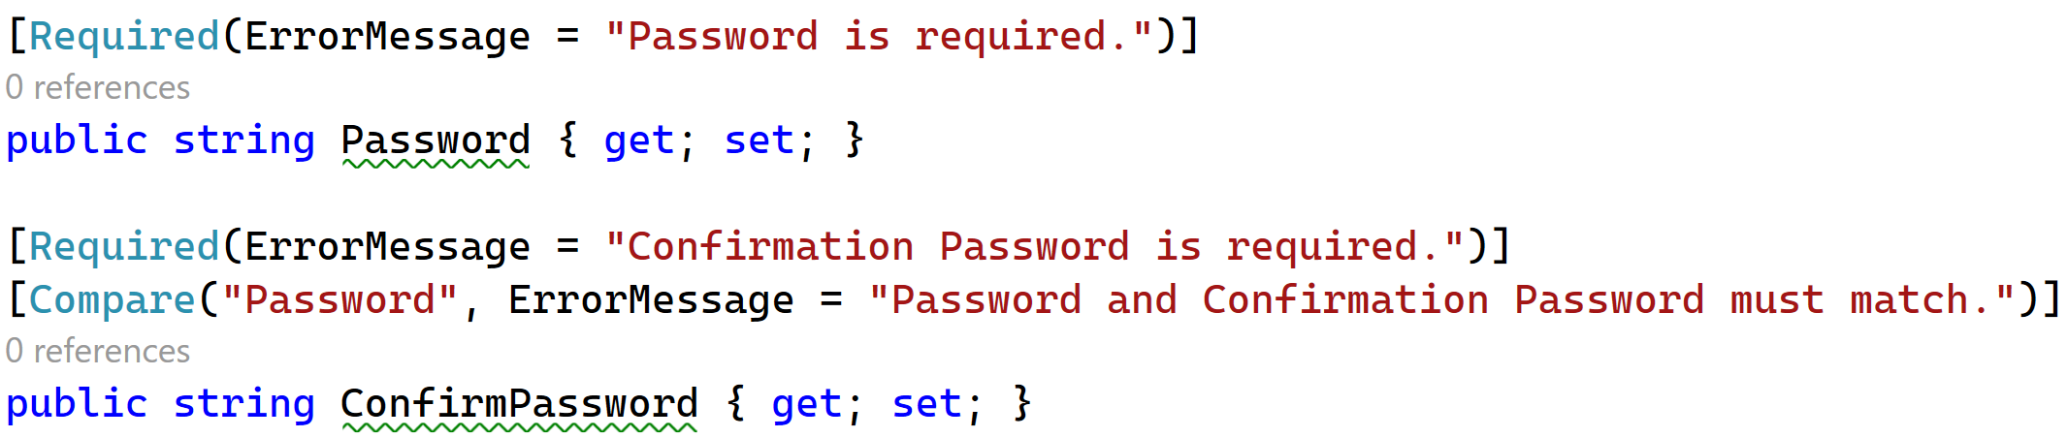
[Compare]
public string Password { get; set; }
[Compare("Password",
ErrorMessage ="Password does not match")]
public string ConfirmPassword { get; set; }
Password does not match
Example

Slide 15
[EmailAddress]
[EmailAddress]
public string Email { get; set; }
Empty The Email field is required.
String does not match The Email field is not a valid e-mail address.
[EmailAddress(ErrorMessage ="Please Enter Valid Email")]
public string Email { get; set; }
Invalid Email Please Enter Valid Email

Slide 16
Employee Model
public class EmployeeModel
{
[Required(ErrorMessage = "First Name is Required")]
[Display(Name = "First name")]
public string FirstName { get; set; }
[Required]
[Display(Name = "Last Name")]
public string LastName { get; set; }
[Required]
[StringLength(10)]
public string MobileNo { get; set; }
[Required(ErrorMessage = "Enter Valid email")]
[EmailAddress]
public string Email { get; set; }
}

Slide 17
Employee.cshtml
<div class="form-group col-md-4">
<h3>Employee Registrtion </h3> <hr />
</div>
<div class="form-row">
<form role="form" method="post" asp-controller="Employee" asp-action="Save">
<div class="form-group">
<div class="form-group col-md-4">
<label><span class="text-danger">*</span>First Name</label>
<input type="text" class="form-control" placeholder="Enter First Name"
asp-for="FirstName">
<span asp-validation-for="FirstName" class="text-danger"></span>
</div>
</div>
<div class="form-group">
<div class="form-group col-md-4">
<label><span class="text-danger">*</span>Last Name</label>
<input type="text" class="form-control" placeholder="Enter Last Code"
asp-for="LastName">
<span asp-validation-for="LastName" class="text-danger"></span>
</div>
</div>

Slide 18
Employee.cshtml
<div class="form-group">
<div class="form-group col-md-4">
<label><span class="text-danger">*</span>Mobile No</label>
<input type="text" class="form-control" placeholder="Enter State Code"
asp-for="MobileNo">
<span asp-validation-for="MobileNo" class="text-danger"></span>
</div>
</div>
<div class="form-group">
<div class="form-group col-md-4">
<label><span class="text-danger">*</span>Email</label>
<input type="text" class="form-control" placeholder="Enter State Code"
asp-for="Email">
<span asp-validation-for="Email" class="text-danger"></span>
</div>
</div>
<br />
<button type="submit" class="btn btn-primary">Save</button>
</form>
</div>

Slide 19
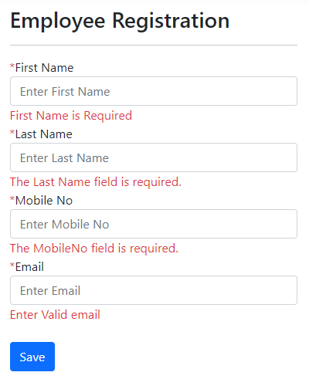
Example: Employee Registration | Client Side Validation

Slide 20
2. Server-Side Validation
User could disable scripts in his browser or do something else to bypass client-side validation, in this case server-side validation must required to protect our data from wrong input.
Server-side validations are also required for ensuring that the received data is correct and valid.
If the received data is valid then we do the further processing with the data.
In this process, if the data not validated, then a response along with proper error message is sent back to the client where these messages are shown to the user so that those wrong entered data can be rectified.
Server-side validations are important before accessing any information provided by user.
In Asp.Net Core, the best way to perform the server-side validation is using Model Validation.

Slide 21
ModelState
ModelState is a property of controller that is used for validating data on server side.
ModelState is a collection of name and value pair that was submitted to the server during post.
It also contains a collection of error messages for each value submitted.
ModelState.IsValid property
ModelState.IsValid property is an inbuilt property which verifies two things:
Whether the Form values are bound to the Model.
All the validations specified inside Model class using Data annotations have been passed.
if (ModelState.IsValid)
{
... do something
}
else
{
... do something
}

Slide 22
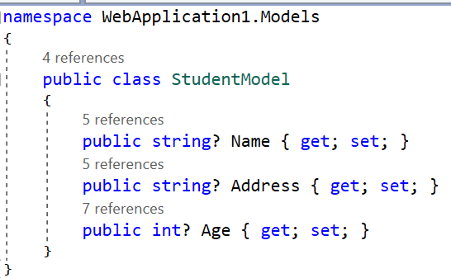
Student Model | Without Annotations

Slide 23
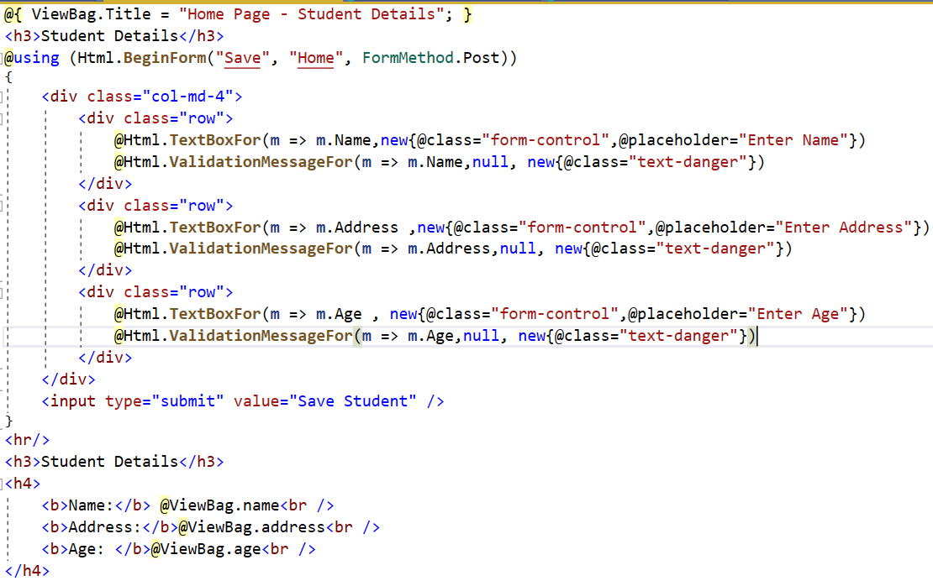
Student Form Design

Slide 24
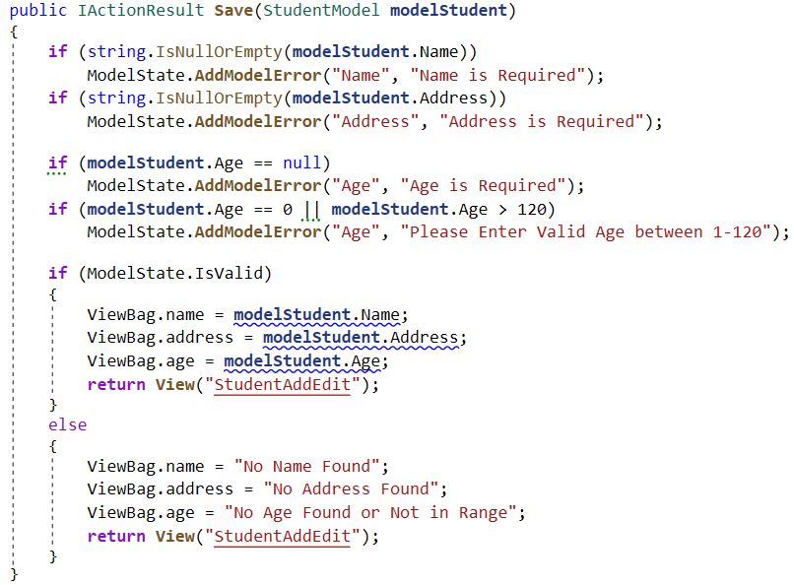
Home Controller Save Action Method

Slide 25
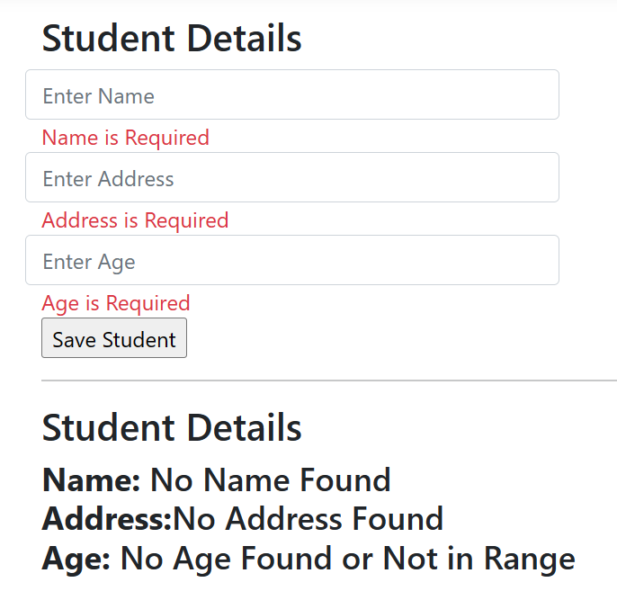
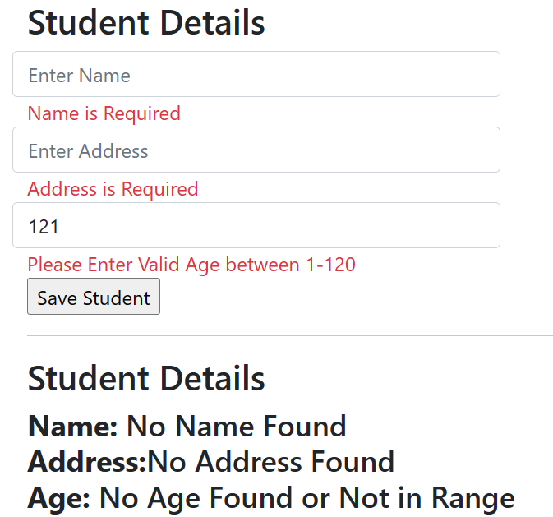
Output

Slide 26
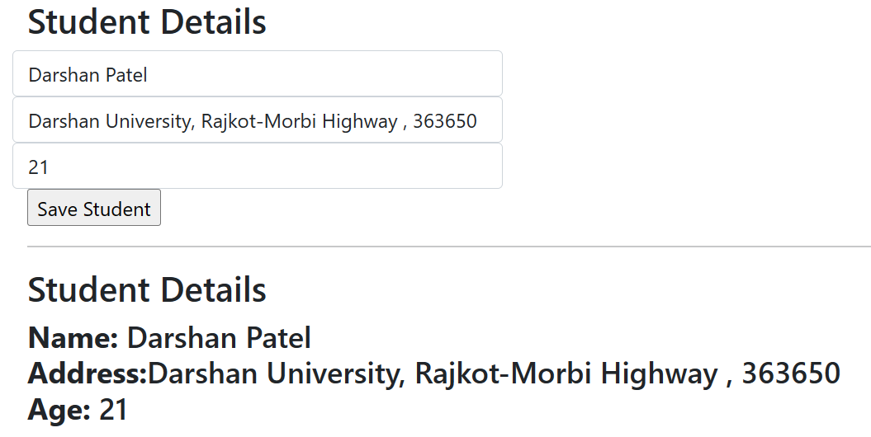
Output

Slide 27
MVC Areas
Section 4.2

Slide 28
Introduction: Areas
ASP.NET Areas is a feature that allows to create a separate module in the application with its own set of Razor Pages, controllers, views, and models.
Areas provide a way to partition an ASP.NET Core Web app into smaller functional groups.
It allows you to logically partition your application into smaller units/modules, making it easier to manage and scale larger applications.
This is very helpful in a large web application, where all the controllers, views, and models have a single set of folders and that becomes easy to manage.
This also helps multiple developers to work on the same web application without interfering with one another.

Slide 29
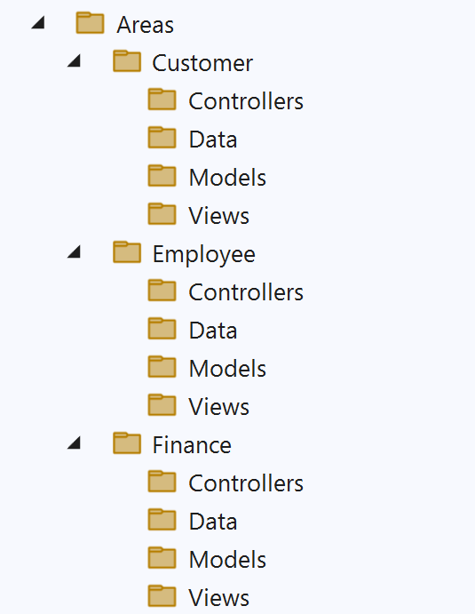
Introduction - Cont..
When to use Area?
The app is made of multiple high-level functional components that can be logically separated.
You want to partition the app so that each functional area can be worked on independently.
For an example, a large enterprise application may have different modules like Customers, Employees, Finance etc.
Each of these units have their own area to contain Views, Controllers, Razor Pages, and models.

Slide 30
How to Add Areas in a Project?
Section 4.3

Slide 31
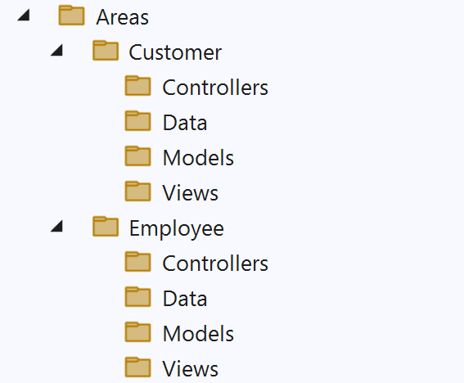
Adding Areas in Project
ASP.NET Core web app using areas, controllers, and views contains the following:
An Area folder structure.
Controllers with the [Area] attribute to associate the controller with the area.
To add area route in Program.cs file.
An area folder structure:

Slide 32
Adding Areas in Project Cont..
Controllers with the [Area] attribute to associate the controller with the area.
The area route added to Program.cs:
Area routes typically use conventional routing rather than attribute routing.
Conventional routing is order-dependent.
In general, routes with areas should be placed above in the route table as they're more specific than without area routes.
[Area(“Customer")]
public class CUS_CustomerController : Controller
{
}
//Program.cs
app.MapControllerRoute(
name: "areas",
pattern: "{area:exists}/{controller=Home}/{action=Index}/{id?}“
);

Slide 33
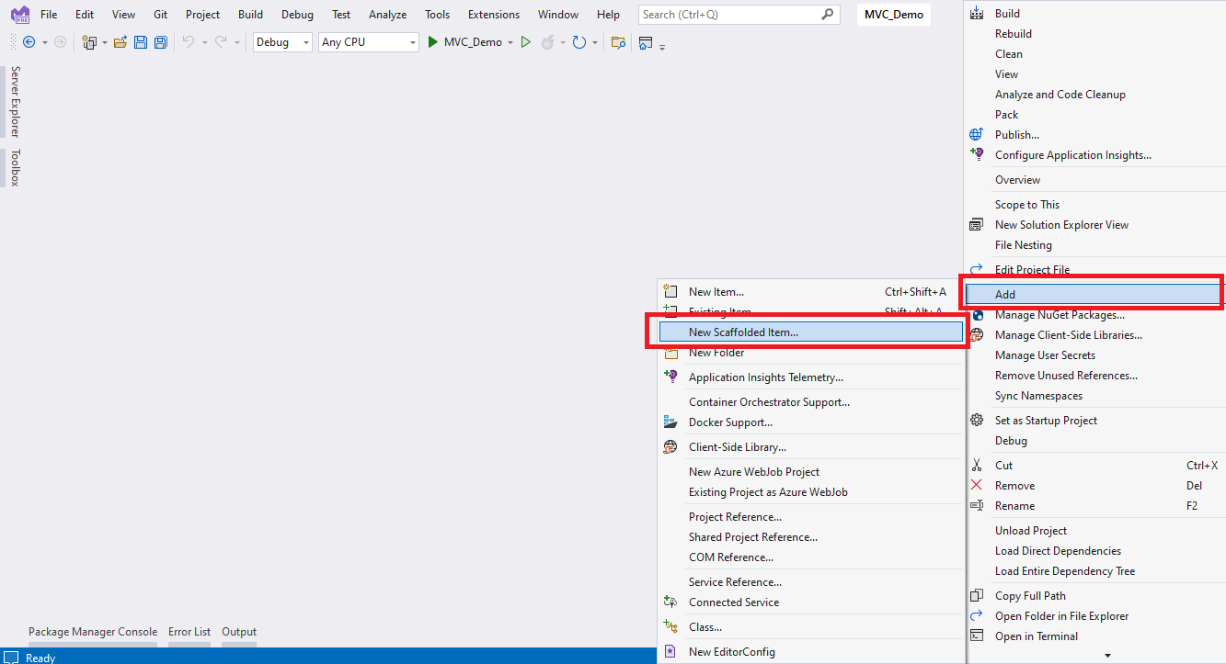
Steps to Add Area in Project
Step 1: Right click on Project → Add →New Scaffolded Item

Slide 34
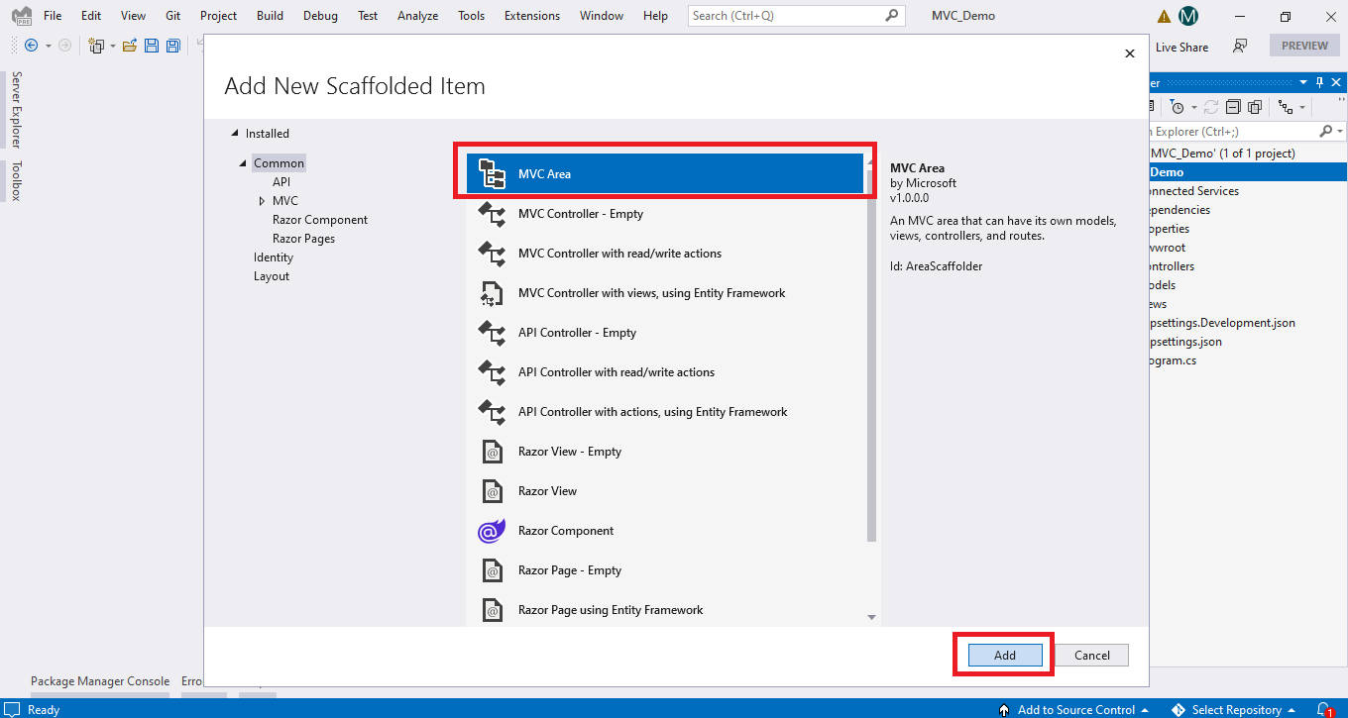
Steps to add Area in project
Step 2: Select MVC Area Click on Add

Slide 35
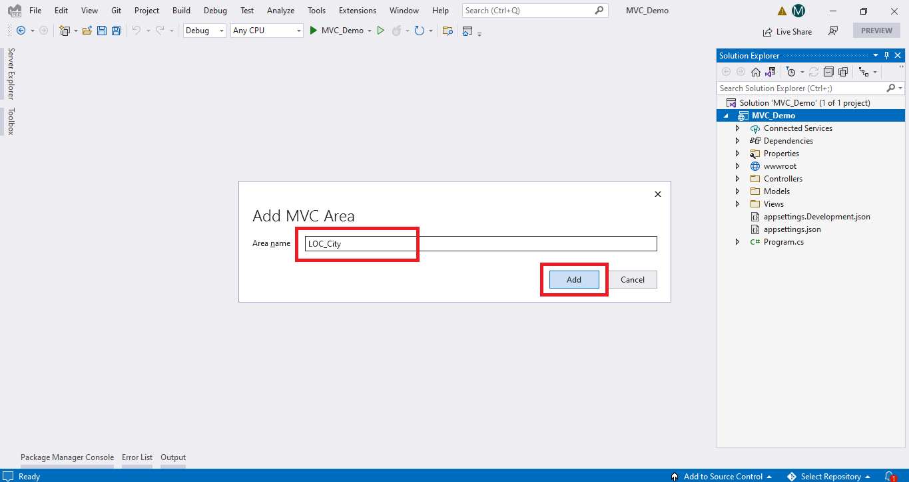
Steps to add Area in project
Step 3: Given Name to Area and Click on Add

Slide 36
Connection & Command Object
Section – 4.7

Slide 37
Connection
The Connection object is the first component of ADO.NET.
The Connection objects provider connectivity to a data source.
It establishes a connection to a specific data source.
Connection object helps in accessing and manipulating a database.
The base class for all Connection objects is the DbConnection class.

Slide 38
Example - Connection String
string connString = "data source=DESKTOP-SJ5GNSA ;
initial catalog=AddressBook; Integrated Security=true; ";
string connString = "data source=DESKTOP-SJ5GNSA ;
initial catalog=AddressBook; user id=abc; password=123;";
SQL Server Name
OR
Instance Name
Database Name
it specifies that connection will be established using windows authentication.
it specifies that connection will be established using sql server authentication.

Slide 39
Connection - Cont..
Properties of Connection Object
Properties | Description
ConnectionString | Connection String is collection of name/value pairs separated by semicolon which gives information of data source with which connection needs to be established.
DataSource | It specifies name of computer and SQL server instance with which connection is required.
IntegratedSecurity | It specifies that connection will be established using windows authentication of SQL Server username/password.
Initial Catalog | It specifies name of database with which connection is required.
User ID | It specifies username to connect with database.
Password | It specifies password to connect with database.

Slide 40
Connection Cont..
Methods of Connection Object
Open(): this method opens connection using information provided by connection string.
Close(): this method closes already opened connection.

Slide 41
Command
The Command object enables access to database commands to return data, modify data, run stored procedures, and send or retrieve parameter information.
It executes a command against a data source.
Exposes parameters and can execute in the scope of a transaction from a connection.
You can execute SQL queries to return data in a DataSet or a DataReader object.
Command object performs the standard Select, Insert, Delete and Update T-SQL operations.
The base class for all command objects is the DbCommand class.

Slide 42
Properties of Command Object
Connection: It specifies that on which connection command executes.
CommandType: It specifies type of Command to execute
Text – SQL Statement as command type
StoredProcedure – Stored Procedure as command type
Table – Table Name as command type
CommandText: Either SQL Statement or name of Stored Procedure or name of Database table.

Slide 43
Methods of Command Object
Method | Description
ExecuteReader() | The ExecuteReader method executes the command specified and returns an instance of SqlDataReader class. It is used to Select data from database.
ExecuteNonQuery() | This method executes the command specifies and returns the number of rows affected. It is used for insert, update and delete operations.
ExecuteScalar() | This method executes the command specifies and returns the first column of first row of the result set. The remaining rows and column are ignored.
ExecuteXmlReader() | This method executes the command specified and returns an instance of XmlReader class. This method can be used to return the result set in the form of an XML document.
CreateCommand() | This method created new command object on given connection object.

Slide 44
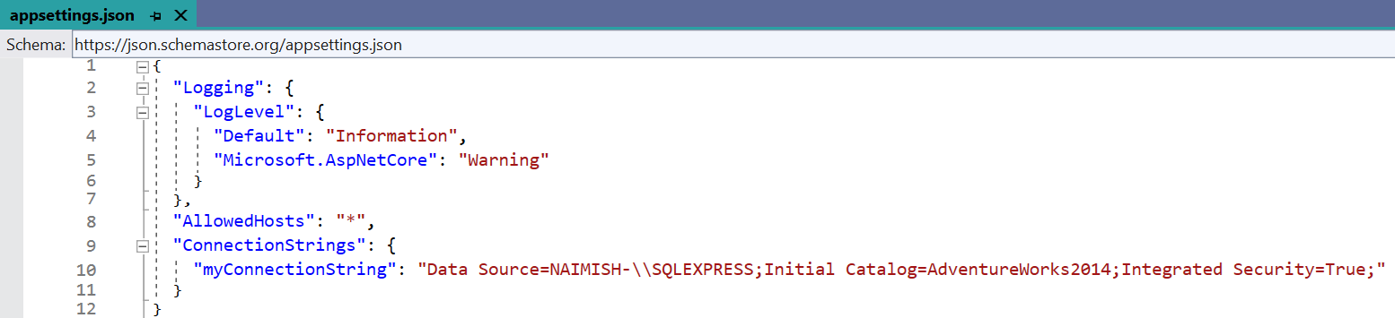
Steps to Connect with Database
Step-1 | Add ConnectionStrings section in appsettings.json

Slide 45
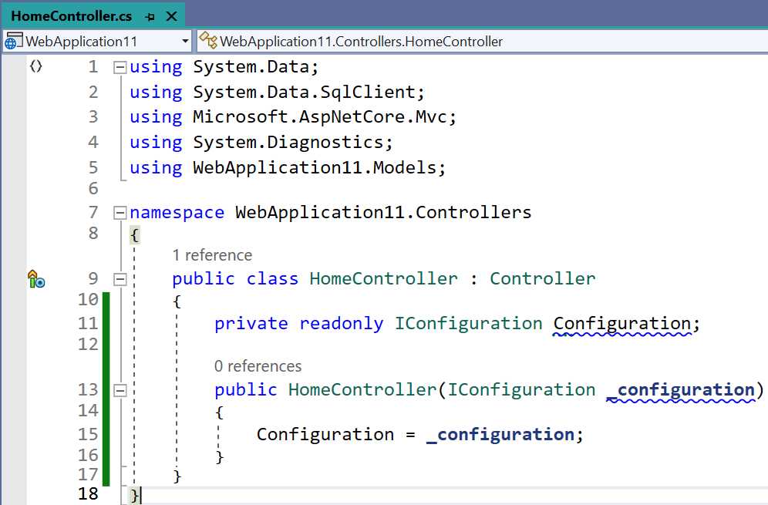
Steps to Connect with Database
Step-2 | Add ConnectionStrings section in appsettings.json

Slide 46
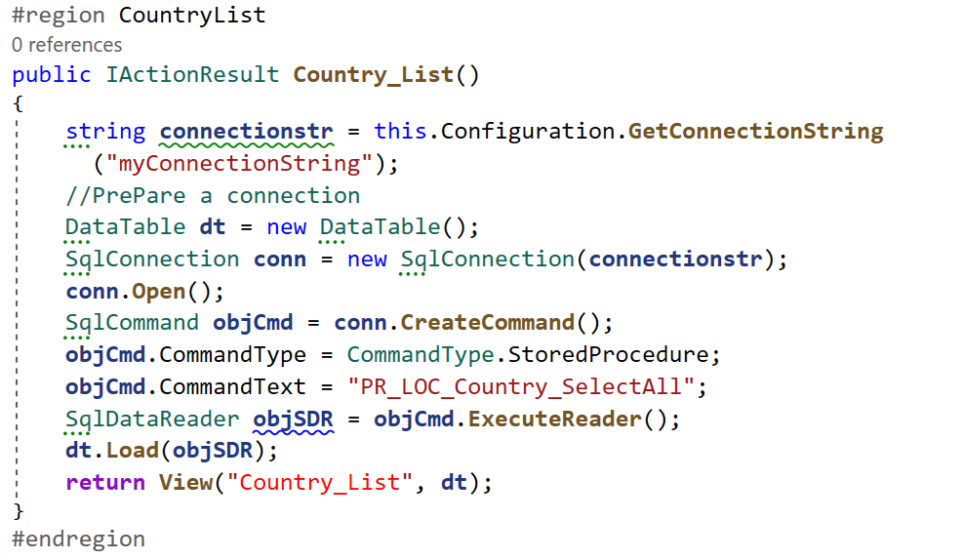
Steps to Connect with Database | Data Retrieval from DB

Slide 47
Model Binding
Section – 4.3

Slide 48
Model Binding
Model binding allows mapping HTTP request data with a model.
It is the procedure of creating .NET objects using the data sent by the browser in an HTTP request.
Model binding is a well-designed bridge between the HTTP request and the C# action methods.
Data from HTTP requests are used by controllers and Razor pages.
Route data, for example, may serve as a record key, while posted form fields may serve as values for model properties.

Slide 49
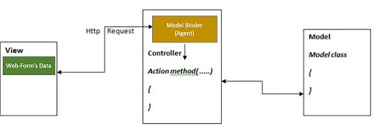
How does it Work?
The model binding mechanism is as follows:
Data is retrieved from a variety of sources, including route data, form fields, and query strings.
In method arguments and public properties, the data is passed to controllers and Razor pages.
Converts data from strings to .NET types.
The converted data is then assigned to the parameters of the action method or properties of the model.

Slide 50
Binding to Action Parameters
When a form is submitted or a request is made to this action, the Default Model Binder automatically maps the form data or query string parameters to the properties of the ‘CustomerModel’ class based on the property names.
[HttpPost]
public IActionResult Save(CustomerModel customer)
{
// Save customer data to database
// ...
return RedirectToAction("Index");
}

Slide 51
Binding to Method Parameters
We can also bind data to individual method parameters.
In this case, the model binder maps values from form fields or query string parameters to the method parameters based on parameter names.
[HttpPost]
public IActionResult Save(int CustomerID, string CustomerName)
{
// Save customer data to database
// ...
return RedirectToAction("Index");
}

Slide 52
Default Model Binder
Section – 4.4

Slide 53
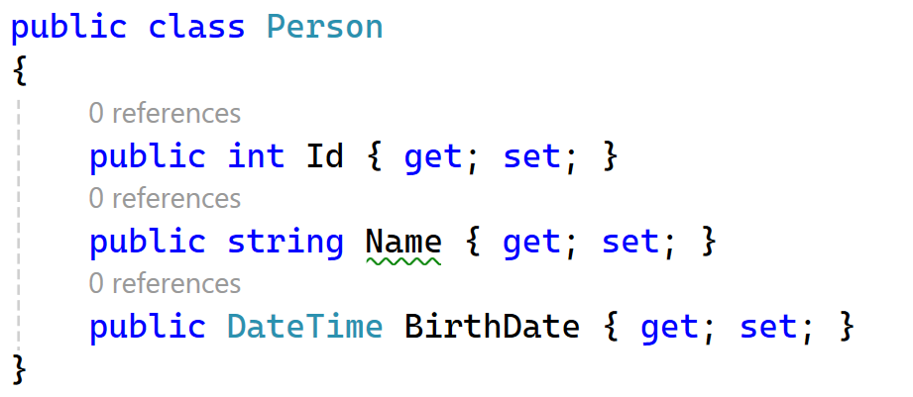
Default Model Binder
The default model binder in ASP.NET Core MVC is designed to handle most common data types and scenarios.
It automatically maps data from HTTP requests to action method parameters or model properties.
Here’s a simple example to illustrate how it works:
Let’s say you have a model class Person and a corresponding action method in your controller:

Slide 54
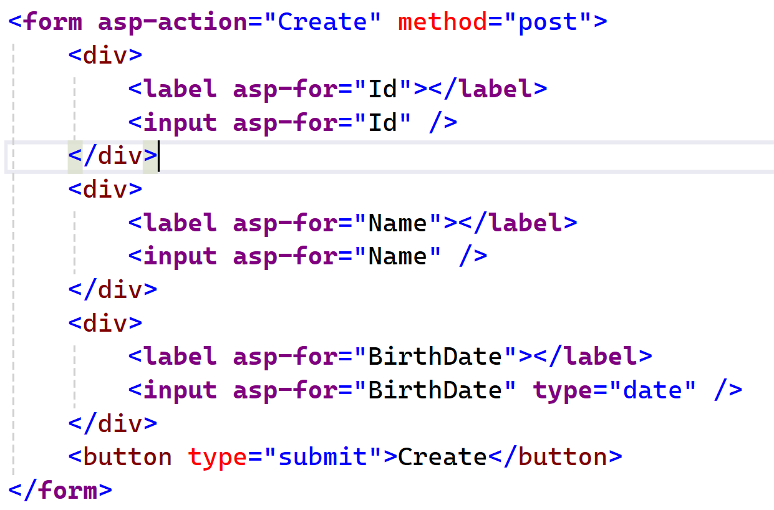
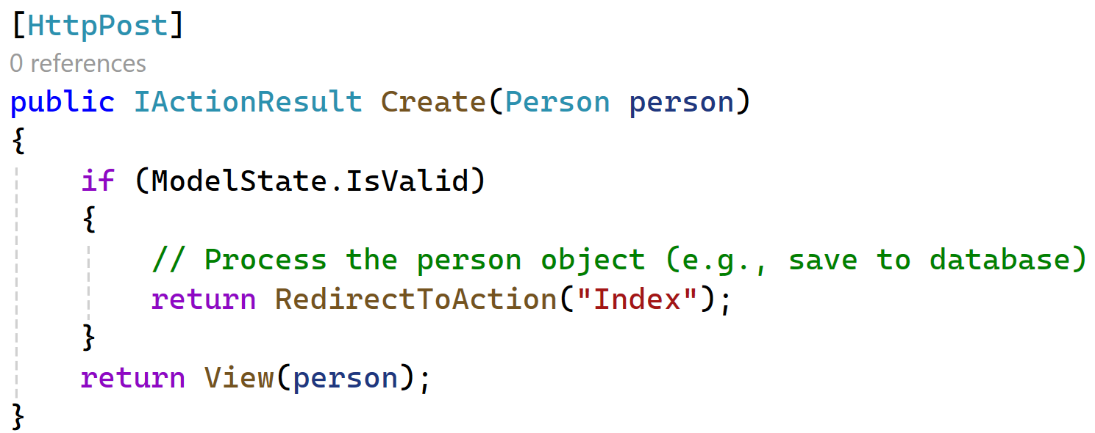
Default Model Binder Cont..
How It Works?
When the form is submitted, the default model binder:
Retrieves Data: Collects data from the form fields.
Converts Data: Converts the string values to the appropriate .NET types (e.g., int, string, DateTime).
Assigns Data: Assigns the converted values to the properties of the Person object.
Validates: Checks the ModelState to ensure all data is valid.

Slide 55
IFormCollection
Section – 4.5

Slide 56
IFormCollection Object
A IFormCollection Object is used to retrieve form input values in action method.
We can retrieve all the controls values using IFormCollection object.
Sometimes we are not working with model and we want to get all data together using key value pair. (Html Id’s)

Slide 57
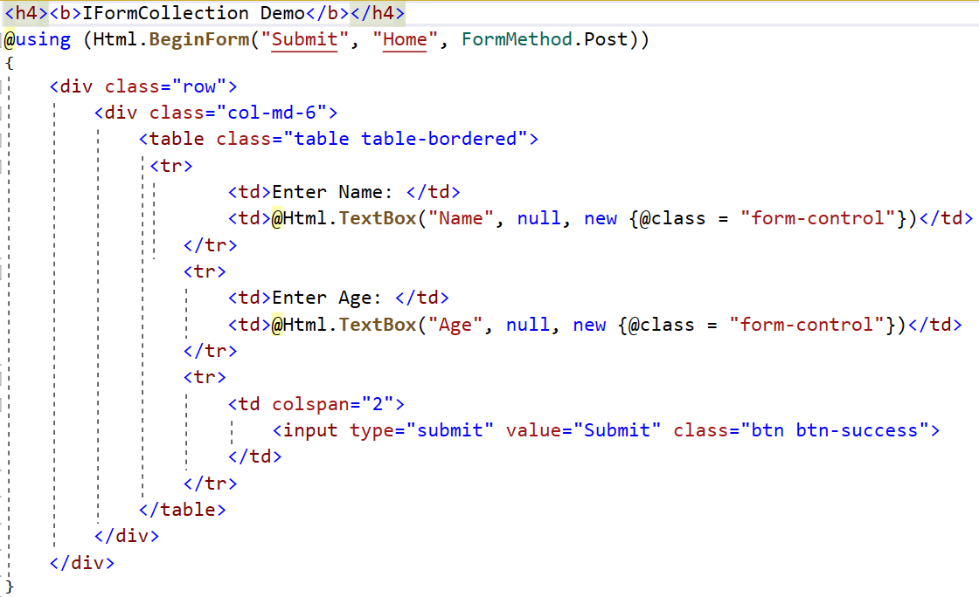
Index.cshtml | Form With Two Text Controls

Slide 58
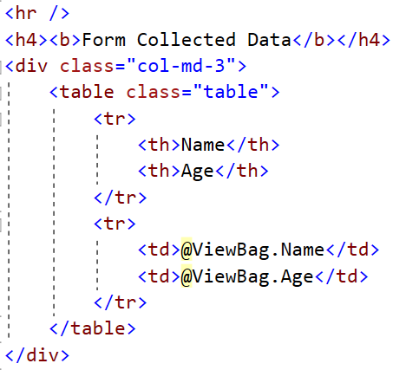
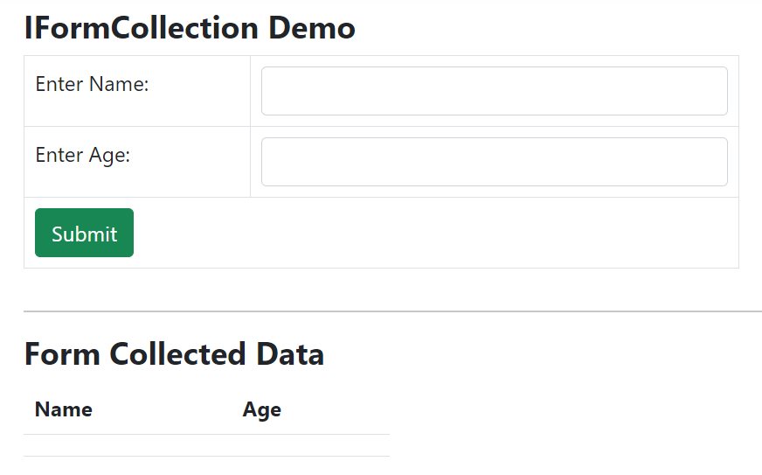
Index.cshtml | Form With Two Text Controls Cont..

Slide 59
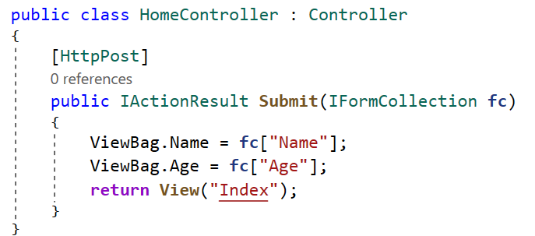
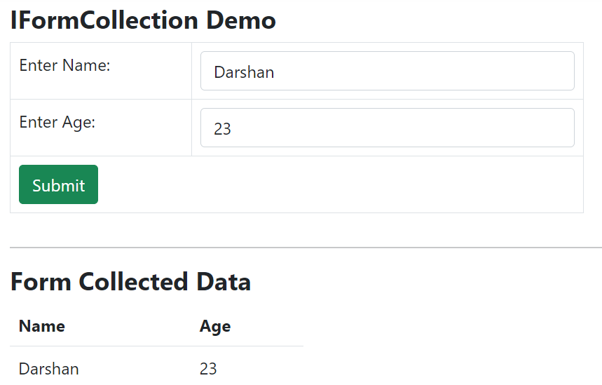
Controller Action Method Code

Slide 60
IFormFile
Section – 4.6

Slide 61
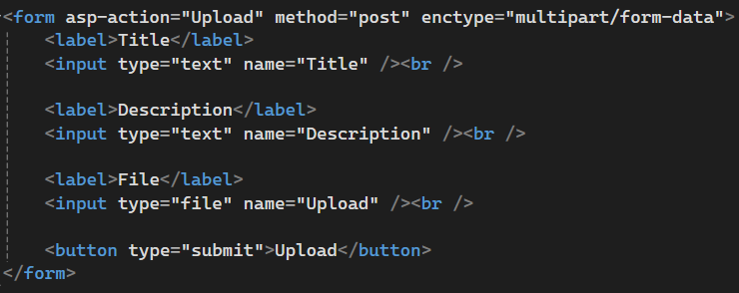
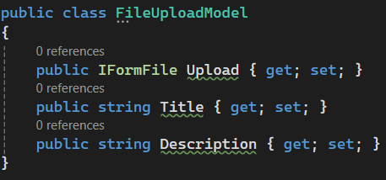
IFormFile
IFormFile is an interface in ASP.NET Core used for uploading files via HTTP requests.
It binds uploaded file data from an HTML <input type="file"> element to a controller action parameter.
ASP.NET Core automatically binds the uploaded file(s) to the IFormFile parameter when the form is submitted via POST.
Example:

Slide 62
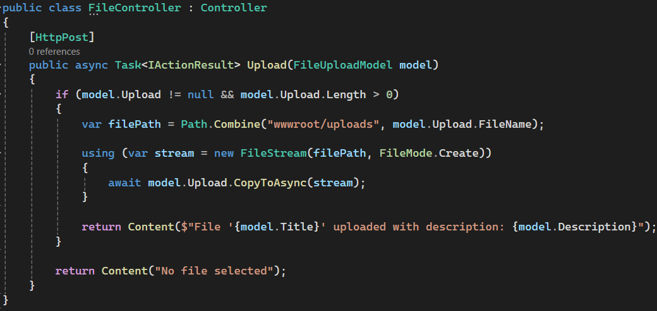
IFormFile

Slide 63
Bind Attribute
Section – 4.7

Slide 64
Bind Attribute
The [Bind] attribute in ASP.NET Core is used to specify which properties of a model should be included during model binding.
It allows you to control which properties are bound from the incoming request data to the model in your controller actions.
This is often used to prevent over-posting attacks, where malicious users attempt to bind and update properties that they shouldn't have access to.
It can be found in Microsoft.AspNetCore.Mvc namespace.
Example: You have a Employee Model as follows
public class EmployeeModel
{
public int ID { get; set; }
public string Name { get; set; }
public string Mobile { get; set; }
public string Email { get; set; }
public string City { get; set; }
}

Slide 65
Bind Attribute - Including Specific Properties
You can use the [Bind] attribute to include only specific properties for binding.
It uses a "whitelist" strategy, whereby only attributes that are explicitly mentioned in the action method arguments are bound by default, and all other properties are not.
For example, you want to bind only Id and Name property then?
public IActionResult Employee([Bind("ID,Name")] EmployeeModel model)
{
// Only 'Id' and 'Name' properties will be bound from the request
return RedirectToAction("Index");
}

Slide 66
Bind Attribute - Prefixing
The [Bind] attribute can also be used to specify a prefix for properties that should be bound.
For example
<form role="form" method="post" asp-area="" asp-controller="FileUpload" asp-action="Employee">
<div class="form-group col-md-4">
<label>Employee Name</label>
<input type="text" name="Employee.Name" class="form-control" />
</div>
<div class="form-group col-md-4">
<label>Mobile</label>
<input type="text" name="Employee.Mobile" class="form-control" />
</div>
<div class="form-group col-md-4">
<label>Email</label>
<input type="text" name="Email" class="form-control" />
</div>
<div class="form-group col-md-4">
<label>City</label>
<input type="text" name="City" class="form-control" />
</div>
<button type="submit" class="btn btn-primary">Save</button>
</form>

Slide 67
Bind Attribute - Prefixing
In Controller we have Employee as follows:
Here only Name and Mobile property will be bound to model from the request. Remaining model properties will not be bound so it will be null.
public IActionResult Employee([Bind(Prefix = "Employee")] EmployeeModel model)
{
// Only 'Name' and 'Mobile' properties will be bound from the request
return RedirectToAction("Index");
}

Slide 68
Session
Section – 4.8

Slide 69
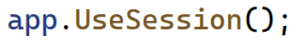
Session
Session management allows you to store user data on the server side while the user interacts with your web application.
This data is tied to a unique session ID, which is sent back and forth between the client and server.
How to Implement Session Management?
Install Required Packages: Ensure you have the necessary packages installed.
You can use the NuGet Package Manager or the .NET CLI to install the Microsoft.AspNetCore.Session package.
Configure Middleware:
In the Configure method of Program.cs, add the session middleware

Slide 70
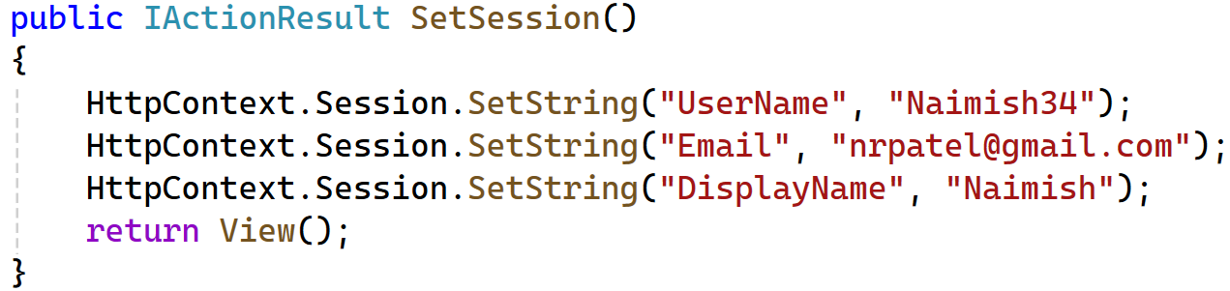
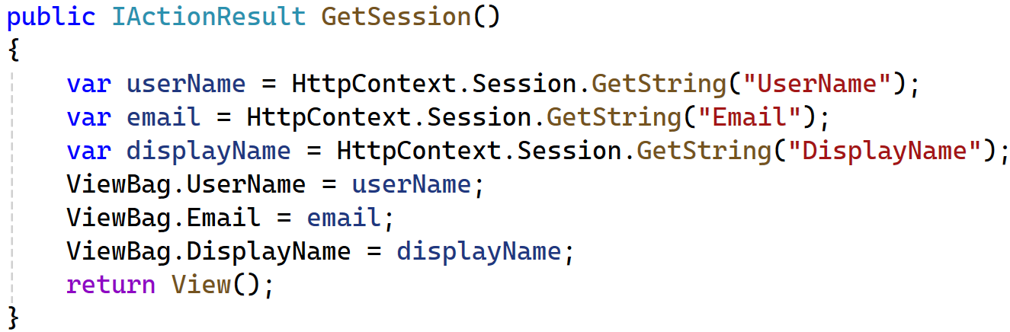
Storing & Retrieving Session Data
You can store data in the session using the HttpContext.Session object in your controllers
Retrieve the stored data using the HttpContext.Session object

Slide 71
Cookies
Section 4.9

Slide 72
Cookies
Cookies are small pieces of data stored on the client’s browser.
Browsers send cookies with every request and hence their size should be kept to a minimum.
They are used to maintain state and user information across multiple requests.
Most likely, you have come across those pretty pop-ups on sites, informing you that they use cookies when you visit for the first time.
Most browsers restrict cookie size to 4096 bytes (4KB) and only a limited number of cookies are available for each domain.
Users can easily tamper with or delete a cookie, it can also expire on their own.
Hence we should not use them to store sensitive information and their values should not be blindly trusted or used without proper validation.
We often use cookies to personalize the content for a known user especially when we just identify a user without authentication.

Slide 73
Cookies Cont..
We can use the cookie to store some basic information like the user’s name.
Then we can use the cookie to access the user’s personalized settings, such as their preferred color theme.
Pros:
Easy to implement.
Useful for maintaining state and user preferences.
Cons:
Limited storage capacity.
Can be a security risk if not handled properly (e.g., storing sensitive information).

Slide 74
Types Of Cookies
Persistent Cookies
Non-persistent Cookies
Persistent Cookies
When cookies are saved within the browser’s temporary folder on the client’s machine, such cookies are said to be persisted, because information saved can be retrieved at any time, so long the cookies expiration date has not passed.
These remain on the user’s device for a specified period or until they are manually deleted.
Non-persistent Cookies (session cookies)
Also known as session or in-memory cookies, these are only useable while the browser is open.
They are not saved locally on the client’s machine.

Slide 75
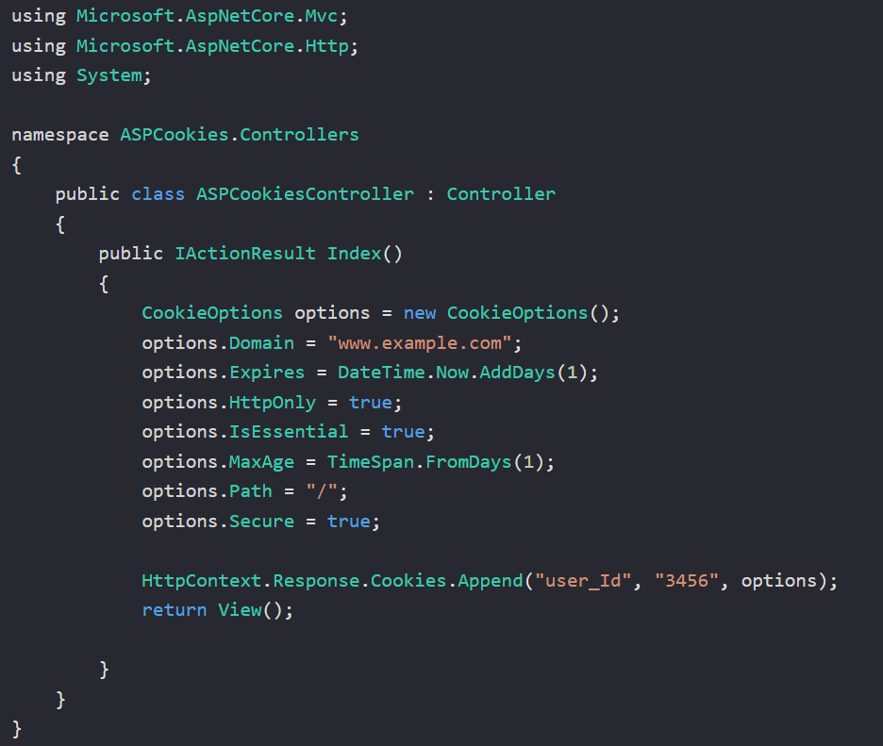
Example : Cookies Creation
The CookieOptions options can be accessed from the Microsoft.AspNetCore.Http namespace and by declaring it’s instance. Some of its options include:
Domain : Gets or Sets the domain to associate the cookie with.
Expires: Gets or Sets the expiration date and time for the cookie.
HttpOnly: Gets or Sets a value indicating if a cookie is accessible by a client-side script.
IsEssential: Indicates if cookie is essential for the application to function properly.
MaxAge: Gets or Sets the cookie’s max age.
Path: Gets or Sets the cookie path.
Secure: Gets or Sets value that indicates whether to transmit the cookie using Secure Socket Layer (SSL) – that is over Https only.

Slide 76
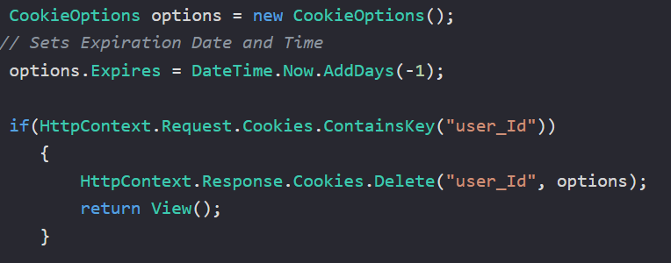
Cookie Deletion
Cookies cannot be directly deleted from the client’s machine.
However, we can remove a cookie by modifying the cookie’s expiration date to a date in the past.
When we do this and a request is sent to the path or domain the cookie was registered to, the browser determines that the cookie has expired, and deletes the cookie.

Slide 77
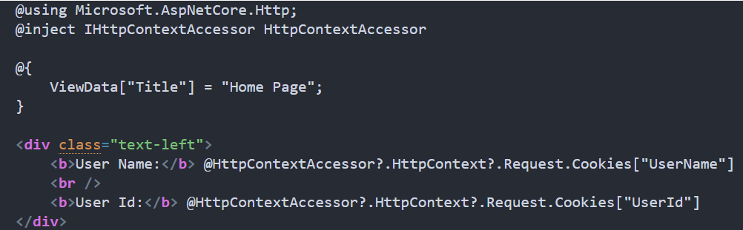
Example : Access the Cookie Object in a View
To use Cookies inside a View, we need to inject the IHttpContextAccessor service into our view and use it to get the HttpContext and Request objects from that.

Slide 78
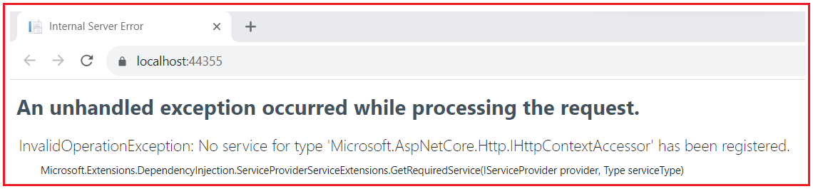
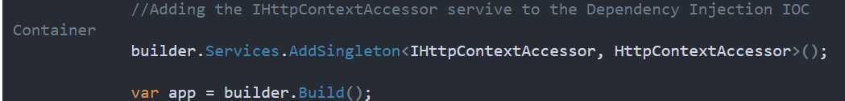
Example : Access the Cookie Object in a View
If you run the application with the above changes, you will get the following exception:
We use the HttpContextAccessor service but have not yet configured it into the built-in IOC container in Program.cs file.

Slide 79
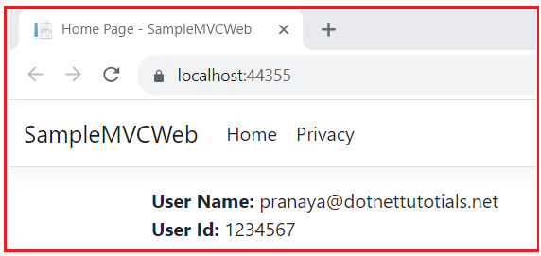
Example : Access the Cookie Object in a View
Now, run the application, and by default it will render the Index view where you can see the cookie data, as shown in below.

Slide 80
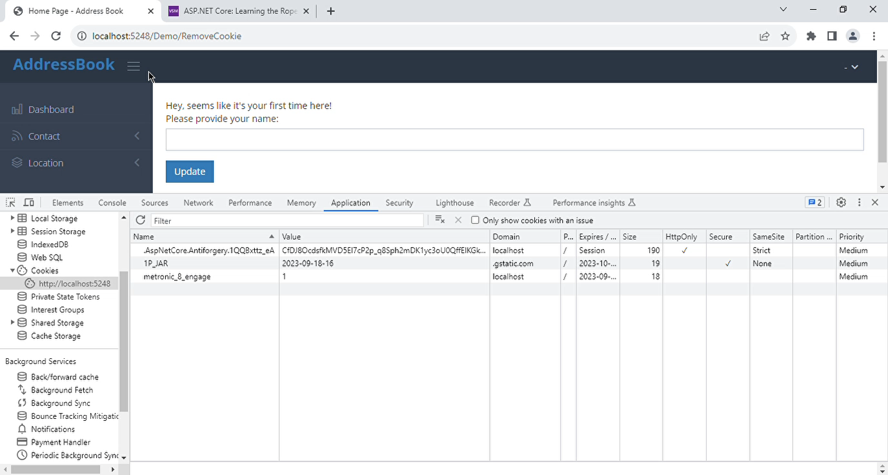
Example : Cookies

Slide 81
Query Strings
Section 4.10

Slide 82
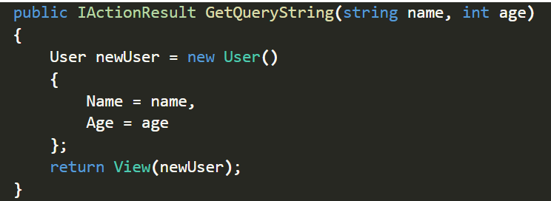
Query Strings
We can pass a limited amount of data from one request to another by adding it to the query string of the new request.
This is useful for capturing the state in a persistent manner and allows the sharing of links with the embedded state.
Model binding maps data from HTTP requests to action method parameters.
So if we provide the values for name and age as either form values, route values or query strings, we can bind those to the parameters of our action method.

Slide 83
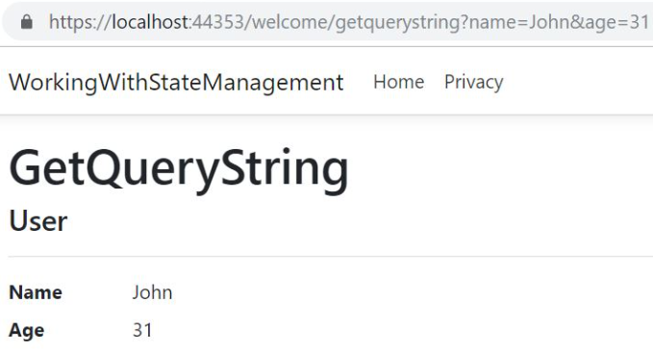
Query Strings
~/welcome/getquerystring?name=John&age=31
As URL query strings are public, we should never use query strings for sensitive data.

Slide 84
Hidden Fields
Section 4.11

Slide 85
Hidden Fields
We can save data in hidden form fields and send it back in the next request.
Sometimes we require some data to be stored on the client side without displaying it on the view page or web page.
Later when the user takes some action, we’ll need that data to be passed on to the server side. (While Edit & Delete Record)
This is a common scenario in many applications and hidden fields provide a good solution for this.

Slide 86
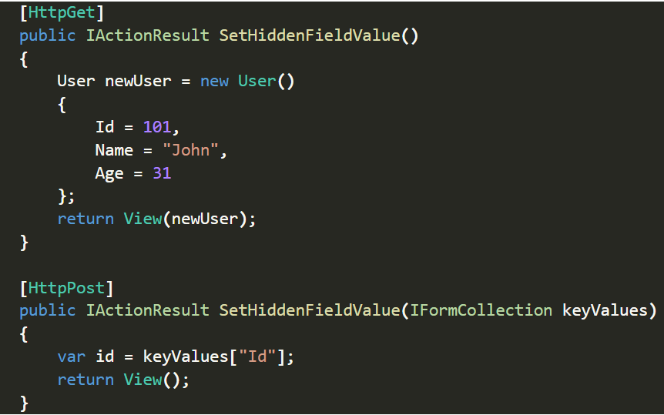
Hidden Fields
The GET version of the SetHiddenFieldValue() method creates a user object and passes that into the view.
We use the POST version of the SetHiddenFieldValue() method to read the value of a hidden field Id from FormCollection.
In the View, we can create a hidden field and bind the Id value from Model:

Slide 87
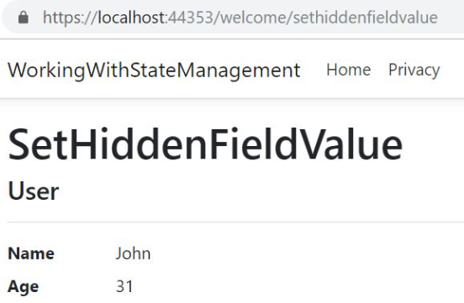
Hidden Fields
Then we can use a submit button to submit the form:
Now let’s run the application and navigate to /Welcome/SetHiddenFieldValue:

Slide 88
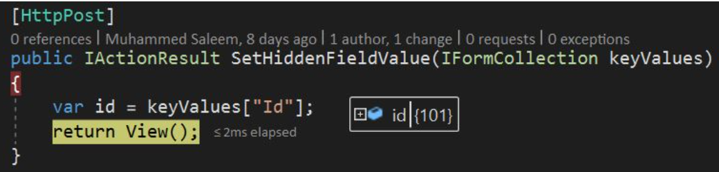
Hidden Fields
On inspecting the page source, we can see that a hidden field is generated on the page with the Id as the value:
Now let’s click the submit button after putting a breakpoint in the POST method.
We can retrieve the Id value from the FormCollection:

Slide 89
Summary

Slide 90
Summary: Data Validation in ASP.NET Core MVC
Overview of Validation
Ensures data integrity and correctness before processing.
Performed on Model properties.
Validations with Data Annotations
Decorate model properties with attributes like:
[Required], [StringLength], [Range], [EmailAddress], [Compare]
Server-Side vs Client-Side Validation
Server-Side: Enforced on form submission (secure & reliable).
Client-Side: JavaScript-based; improves UX with instant feedback.

Slide 91
Summary: Working with Areas
Understanding Areas
Logical partitioning of large MVC applications (like sub-apps).
Separates controllers, views, and models by feature.
Adding & Defining Areas
Create folders under Areas/AreaName/Controllers, etc.
Use [Area("Admin")] attribute.
Defining Area Routes
Add routes in Program.cs or via attribute routing. For example,
[Area("Admin")]
[Route("Admin/[controller]/[action]")]

Slide 92
Summary: Model Binding Techniques
Default Model Binder
Binds form inputs to action parameters using naming conventions.
IFormCollection Model Binding
Access raw form data via IFormCollection formData.
IFormFile Model Binder
Used to upload files via <input type="file" />.
[Bind] Attribute
Limits binding to specific properties:
public IActionResult Save([Bind("Name,Email")] UserModel user)

Slide 93
Summary: State Management in ASP.NET Core
Connection & Command Object
Used in ADO.NET for DB interaction.
SqlConnection, SqlCommand
Cookies
Small data stored on client machine.
Use Response.Cookies.Append() and Request.Cookies[].
Session
Server-side user data store.
Access via HttpContext.Session.SetString() / .GetString()
Hidden Fields
Store temporary data in forms: <input type="hidden" />
Query Strings
Append data to URL: /product/details?id=5

Slide 94


ASP.NET Core
#2101CS511
Prof. Naimish R. Vadodariya
Computer Science & Engineering Department
Naimish.vadodariya@darshan.ac.in
8866215253

